Slide 1
Susan Hayden Gray, MD, FAAP
Make it Stop!
Strategies for Managing Heavy Menstrual Bleeding for Patients with Bleeding and Clotting Disorders

Slide 2
Disclosures
No conflicts of interest.
I will be discussing off label use of contraceptives for use as menstrual management, and schedules for taking them that are considered off-label by the US Food and Drug Administration, but standard of care for some conditions.
I will be using brand names in some circumstances to clarify different hormonal products, this does not imply endorsement of a particular brand.

Slide 3
Objectives
1. Become familiar with hormonal methods that can be used for menstrual management for patients with bleeding and clotting problems.
2. Know where to find information about hormone safety for medically complex patients.
3. Discuss a few newer hormonal methods that may have a unique role for patients with bleeding and clotting problems.

Slide 4
Spoiler alert
When in doubt, leave estrogen out.
Think outside the box: the best choice is often an IUD.

Slide 5
Preferred Language
Heavy menstrual bleeding (HMB)
Reflects patient’s subjective experience of blood loss
Abnormal uterine bleeding (AUB)
“bleeding from the uterine corpus that is abnormal in regularity, volume, frequency or duration and occurs in the absence of pregnancy”
Acute “Of sufficient quantity to require immediate intervention to prevent further blood loss”
Chronic: present for 6 months.
ACOG committee opinion no. 557 Obstet Gynecol 2013.

Slide 6
What does “heavy” mean to patients?
Large volume
Painful
Long in duration
Presence of clots
Flooding
Occurring frequently
All of the above?
Source: Gemma Correll, with permission.
Agoodson.com

Slide 7
What is normal /average?
Median age menarche 11.9-12.4 years
Mean cycle interval 32.2 days
Menstrual cycle interval 21-45 days
Menstrual flow length 7 days or less
Menstrual product use 3-6 pads or tampons/day
Source: ACOG Committee Opinion No. 651: Menstruation in Girls and Adolescents: Using the Menstrual Cycle as a Vital Sign. Obstet Gynecol 2015.
Notes:
32.2 days in first gynecologic year

Slide 8
Case #1: 17 year old with lupus and pulmonary emboli
2 pulmonary emboli
Antiphospholipid antibody syndrome
Heavy menstrual bleeding and iron deficiency anemia with anticoagulation
Has difficulty remembering to take pills
Recently began having sex and needs contraception

Slide 9
Case #2: 12 year old with Von Willebrand’s disease
First menses:
Syncope at school
comes into ER with bleeding lasting 2 weeks, Hgb of 8

Slide 10
Case #3
16 year old whose mother has a history of DVT with birth control pill use
Wants to have “a regular period, like my friends”

Slide 11
What is the right treatment for these patients?
Notes:
So what I’d like to do today is to talk about a framework by which you might try to figure out both what is SAFE for these patients and what they might PREFER.
There’s not always a clear answer to what the right choice is, and the right choice may change over time.
In order to figure out how to help, we need to go back for a moment and think about menstrual physiology.

Slide 12
Strategies used for menstrual management
Hormone Therapies
Estrogen containing
Progestin only
GnRH agonists
NSAIDs (ibuprofen, naproxen, mefenamic acid)
Antifibrinolytics
Surgical procedures
Endometrial ablation
Hysterectomy
Notes:
For the purposes of this talk, I’m going to focus on hormonal therapies for menstrual management, but I’d like to point out that there are nonhormonal strategies as well, including Nonsteroidal anti-inflammatory medications, tranexamic acid (which is an antifibrinolytic known by the brand name Lysteda in the US), and surgical procedures which are rarely used in pediatrics.

Slide 13
Menstrual History questions
Last menstrual period is a vital sign! Document it in chart
Time of menarche
Pattern of bleeding: Regular, Irregular
Interval of 21-40 days may be normal
How many days?
<3 or >7 may be abnormal (or anyone with anemia)
Skipping periods
Missing activities/quality of life
Don’t forget to ask about SEX--confidentially
Notes:
So, how do we know what kind of periods are abnormal?
In taking a menstrual history, it is important to ask the timing of the last menstrual period and the time of menarche
It’s important to ask about whether bleeding is regular or irregular, and ideally to use objective data from a menstrual calendar, counting from the first day of one period to the next.
Teens have been shown to be very reliable reporting periods using APPS.
Intervals lasting between 21 and 40 days may be normal for teenagers.
Bleeding that lasts less than 3 days or more than 7 days may be abnormal, or anyone who is anemic without another explanation of blood loss.
Signs of excessive bleeding include syncope, dizziness, chest pain, flooding or gushing.
Amenorrhea for more than 3 months is abnormal, even in the first gynecologic year, and should be evaluated.
And then impact on missing activities and quality of life
And lastly, don’t forget to ask about sexual activity, ideally without a parent in the room

Slide 14
Progestin containing intrauterine devices (LNG-IUD)
All produce unpredictable bleeding initially but overall reduce volume of bleeding.
Low systemic absorption
Very little effect on VTE risk
Table on next page adapted from
Kaiser Family Foundation
Notes:
I want to give you a rapid tour of available hormone methods in the US before talking about how to decide which method is right for which patient.
We we will start with IUDs.
In 2017 the American College of Obstetrics and Gynecology announced that long acting reversible contraceptive methods should be considered as first choices for teenagers needing contraceptions
These are the inserters for a Skyla IUD on the L and a Mirena IUD on the Right—the purple and red parts are the IUD, which is retracted into the plastic inserter and then is inserted through the cervix during a pelvic exam.
You can see that the size of the device that remains in the patient’s body is the size of a quarter.

Slide 15
IUDs available in USA
 | Progestin Dose (mg of levonorgestrel) | Year approved by FDA | Years effective (FDA label) | Bleeding pattern | Of note
Paragard® | 0 | 1988 | 10 | Heavier, crampier | DO NOT USE if anticoagulated
Mirena® | 52 | 2001 | 8 | 50% amenorrhea at 2 years | FDA approved for heavy menses, reduces overall bleeding by 90%
Liletta® | 52 | 2015 | 8 | 38% amenorrhea at 3 years | Lower cost
Skyla® | 13.5 | 2013 | 3 | 12% amenorrhea at 3 years | Slightly smaller, menses tend to continue
Kyleena® | 19.5 | 2016 | 5 | 23% amenorrhea at 5 years | Slightly smaller
Source: Adapted from Kaiser Family Foundation
Notes:
This is a chart of IUDs FDA approved in the USA, by progestin dose, year they became available, how long they can be used, and bleeding pattern they produce.
The most important one to know about is the second one, the MIRENA brandname IUD.
The Mirena IUD contains 52 mg of Levonorgestrel and has an FDA indication for heavy bleeding in addition to contraception . It can be left in place for 6 years, and about half of patients have amenorrhea, but the other half may have unscheduled and usually light bleeding. It is extremely effective as contraception→99% effective, but it is not the most effective at menstrual suppression.

Slide 16
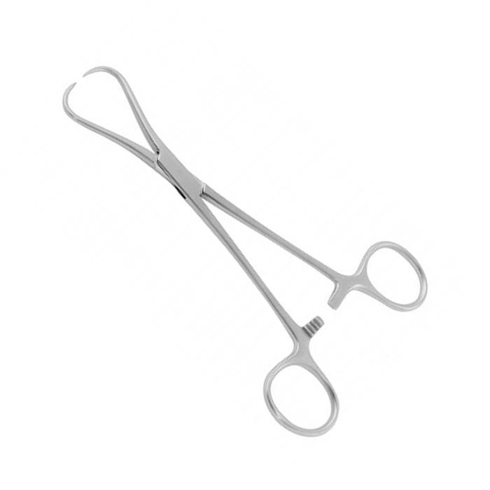
IUD insertion: sedation may be required
and I do IUD insertions without sedation, and we call our colleague Michelle Rindos in gynecology who does them in the operating room.
Be aware of #IUD TikTok!
Notes:
It is important to note that IUD insertion can be challenging in nulliparous patients. I show this tool, which is a cervical tenaculum, to help you imagine the procedure. We use a tenaculum to grasp the cervix with these “teeth” in order to hold it in place. This causes bleeding and really hurts sometimes, and sometimes sedation truly is necessary. Here at UVA we do IUD insertions in our office without sedation, and we call our colleagues in gynecology if we need one done in the operating room.

Slide 17
Subdermal implant (Nexplanon®)
Lasts up to 4 years
Unpredictable bleeding pattern, 10% heavier
No evidence of increased risk of VTE—but its FDA label is based on old data
Notes:
The subdermal implant Nexplanon is another LARC (Long acting reversible contraceptive)
It can be left in for 4 years
The bleeding pattern is very unpredictable—about 40% get amenorrhea, but 10% get heavier bleeding
It does not appear to affect bone density
Because it’s placed under the skin, it’s not a good choice for girls who pick at their skin, as some girls with developmental disorders may

Slide 18
Depot medroxyprogesterone acetate (DMPA, Depo Provera®)
Subcutaneous (104 mcg) or Intramuscular (150 mcg) injection q 3 months
Initial irregular bleeding
Slight increase in VTE—avoid in high risk patients
Weight gain, Acne, hair loss
Notes:
Subcutanerous or Intramuscular injection every 3 months
Initial irregular bleeding, although after the second injection about 2/3 hav amenorrhea
Weight gain 5-8 lbs/year (3-4 kg)

Slide 19
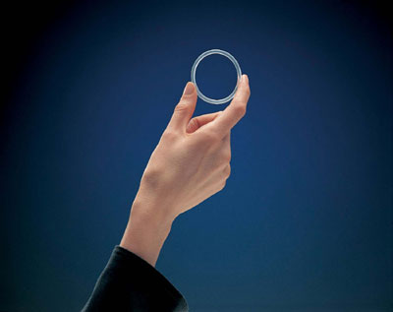
Intravaginal Ring (etonogestrel /ethinyl estradiol, Nuvaring® AND segesterone acetate/ethinyl estradiol, Annovera ®)
Notes:
Many pediatric providers have not seen what the intravaginal ring, brand name Nuvaring looks like.
It is a flexible ring the size of a hair elastic and releases 15 mcg of ethinyl estradiol and also a progestin etonorgestrel, daily

Slide 20
Intravaginal ring
Typical schedule: place 3 weeks, remove for 1 week
OR can be used continuously—leave in 4 weeks, replace ***off label
(Annual ring continuous use has not been studied)
Notes:
The Nuvaring can be placed by the patient using a tampon applicator.
In general it can be placed for 3 weeks, then removed for 1 week to have menses, but there is enough medication for up to 5 weeks, so
It can be used continuously for 4 weeks at a time, then another one placed, for menstrual suppression

Slide 21
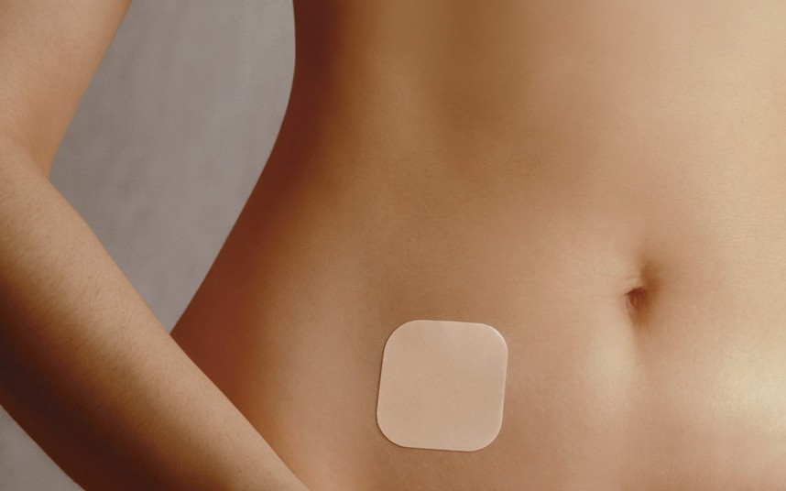
Contraceptive patches (norelgestromin /ethinyl estradiol, Xulane ®; AND levonorgestrel/ethinyl estradiol, Twirla ®)
Notes:
The combined hormonal contraceptive patch is called Xulane in the US.
It is left in place for a week, using one patch per week for 3 weeks, then removing the patch to have a menstrual period during the fourth week.

Slide 22
Contraceptive patch
Adherence better than pills for teens
Side effects: headache, nausea, tape reactions
? risk of VTE compared to pills: data conflicting for norelgestromin patch
Continuous use generally not recommended
Notes:
Adherence better than pills because you replace it once a week instead of having to do something every day.
Side effects include headache, nausea, reactions to the adhesive tape
There is some suggestion that the risk of blood clot is higher compared to pills:
The data on this is conflicting, but in general Continuous use is not recommended

Slide 23
Extended cycle or continuous combined (+ estrogen) hormonal contraceptives
84/7 or Continuous (no placebos)
Cochrane review: no increased risk of thrombosis over traditional schedule
Great patient satisfaction
Notes:
For many patients, extended cycle combined hormonal contraceptives may be the best option for controlling their periods.
Patients can be prescribed 84/7 pills, with 84 days of hormones and then 7 days of placebo, to bring on a menstrual period only 4 times a year.
They can also be prescribed a continuous pill with no scheduled withdrawal bleeding.
There is a Cochrane review that suggests there is no increased safety risk for extended schedule combined pills, although the data is limited.
And patients are very happy with these schedules.
For example,
91% of women in the initial trial of Seasonale refused to go back to their normal schedule
Don’t read
N B Loudon, M Foxwell, D M Potts, A L Guild, R V Short
Br Med J. 1977 Aug 20; 2(6085): 487–490. doi: 10.1136/bmj.2.6085.487

Slide 24
Progestin only pills—high dose
Norethindrone acetate (NETA) used 2.5-5 mg daily
for abnormal bleeding and endometriosis
this dose *off label for contraception
Higher doses converted to estradiol
Higher VTE risk than other progestin only pills (i.e. minipills)
Side effects: bloating, increased appetite
Notes:
Also used off label as add back therapy to preserve bone health in women using Lupron

Slide 25
Progestin only pills—NEW concept
Drosperinone-only 24/4 pill with 24 hour dosing window!
Although EE pills containing DRSP are associated with higher VTE risk, DRSP only is NOT
Great way to deliver scheduled bleeding for patients with contraindications to estrogen

Slide 26
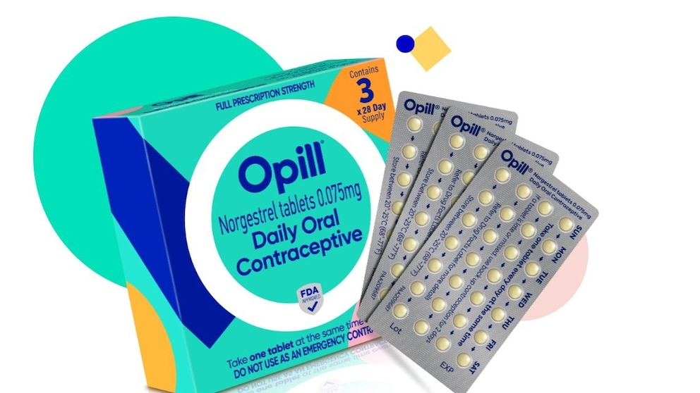
Progestin only pills—SUPER NEW CONCEPT
OVER THE COUNTER as of March!!
Norgestrel 0.075 mg daily “minipill”
No recent studies about bleeding pattern, should expect unpredictable
Notes:
Online by mail, and in stores as of March 2024
3 months $49.99; 6 months $89.99
Efficacy is from cervical mucus thickening, not necessarily inhibition of ovulation
3 HOUR WINDOW

Slide 27
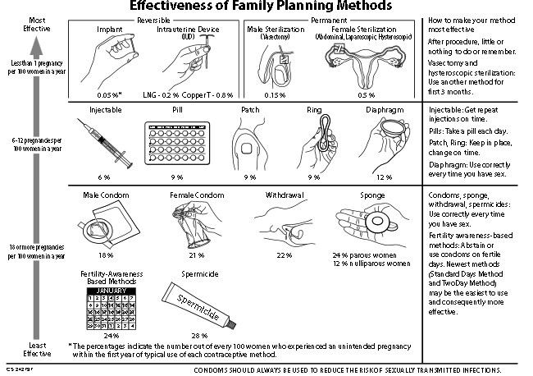
What is the goal? Contraceptive Efficacy
Notes:
Most of us may be used to thinking about birth control methods in terms of contraceptive efficacy.
This chart is a decisionmaking tool organized by contraceptive efficacy of methods. It starts on the top with long acting methods like IUDs with the highest efficacy.
But for the purposes of menstrual management, we need to think about contraception differently.

Slide 28
What is the goal? Amenorrhea
Hormonal contraceptive | Rate amenorrhea at 1 year | Comments
Continuous Norethindrone Acetate (2.5-5 mg daily)¹ | 94% | Side effects: bloating, appetite Expensive
Continuous combined hormonal contraceptive (including ring) ² | 80-90% | Prior authorization sometimes required
DMPA injections³ | 70-75% (incr with time) | Side effects: weight gain, ? Bone density
Mirena IUD⁴ | 40-50% | Other 50% greatly reduced, FDA indication for HMB
Etonogestrel subdermal implant⁵ | 40% | 10% get heavier bleeding
1. Vercellini P et al. Fertil Steril. 2016.
2. Teichmann A et al. Contraception. 2009.
3, 4, 5. Depo Provera, Mirena, and Nexplanon package inserts.
Notes:
For many patients, such as patients with bleeding disorders or disabilities, the goal of menstrual management is achieving as little blood loss as possible.
For example, some girls with autism can’t handle the tactile sensation of having a period.
This list ranks the hormonal methods in terms of success at achieving amenorrhea after a year of use.
Most of these methods bring on unpredictable bleeding, initially and so if rapid onset of amenorrhea is desired, such as for bone marrow transplant or chemotherapy, GnRH agonists are recommended instead
I think many health care providers are surprised to see the Mirena IUD here at the bottom of the list—I mention it by brand name because it is the only IUD with FDA indication for heavy menstrual bleeding, or HMB. At one-two years, only 50% of Mirena users have total amenorrhea, but the other half have significantly reduced flow, but flow that is not predictable. Sometimes that is good enough for the patient, and sometimes not.

Slide 29
What is the goal? Not causing a VTE
Hormonal contraceptive | + | -
Paragard | Hormone free, excellent contraception | Heavier bleeding on “natural” cycle
LNG-IUS | Excellent contraception, less bleeding | Unpredictable bleeding initially
Etonogestrel subdermal implant | Excellent contraception | Unpredictable bleeding
Progestin only “minipill” | ^{Now available OTC} | Unpredictable bleeding, less effective as contraceptive
^{DRSP only} | ^{Predictable bleeding} | Less studied
.
Notes:
For many patients, such as patients with bleeding disorders or disabilities, the goal of menstrual management is achieving as little blood loss as possible.
For example, some girls with autism can’t handle the tactile sensation of having a period.
This list ranks the hormonal methods in terms of success at achieving amenorrhea after a year of use.
Most of these methods bring on unpredictable bleeding, initially and so if rapid onset of amenorrhea is desired, such as for bone marrow transplant or chemotherapy, GnRH agonists are recommended instead
I think many health care providers are surprised to see the Mirena IUD here at the bottom of the list—I mention it by brand name because it is the only IUD with FDA indication for heavy menstrual bleeding, or HMB. At one-two years, only 50% of Mirena users have total amenorrhea, but the other half have significantly reduced flow, but flow that is not predictable. Sometimes that is good enough for the patient, and sometimes not.

Slide 30
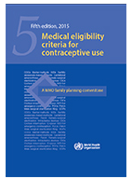
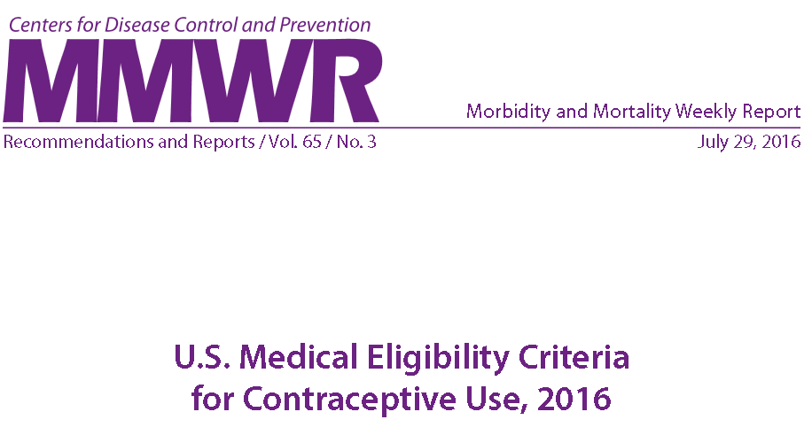
WHO and CDC Medical eligibility criteria (MEC)
https://www.cdc.gov/mmwr/volumes/65/rr/rr6503a1.htm?s_cid=rr6503a1_w
http://www.who.int/reproductivehealth/publications/family_planning/MEC-5/en/
Notes:
So how do we know if there is a contraindication to using a particular medication for my patient, and where’s the best place to find this information? Medical eligibility for contraceptive use , or MEC, were first developed by the World Health Organization in 1996. The US Centers for Disease Control began producing its own version for use in the US, and it’s updated regularly, with the most recent guidelines being from 2016

Slide 31
Key:
1 No restriction (method can be used)
2 Advantages generally outweigh theoretical or proven risks
3 | Theoretical or proven risks usually outweigh the advantages
4 Unacceptable health risk (method not to be used)
Notes:
Green is good, Red is Bad

Slide 32
Examples of contraindications to estrogen use
Migraine with aura
Uncontrolled hypertension
Known thrombophilia or current DVT, PE or Stroke
Major surgery with prolonged immobilization
Breast cancer
Severe cirrhosis
Solid organ transplant complicated by rejection
Pulmonary hypertension
Acute hepatitis
Notes:
Here are some examples of level 4 contraindications to estrogen

Slide 33
Thrombosis: synergistic risk factors
Risk Factor | Risk Estimate | +COCs Risk Estimate | Recommendations to reduce risk
Otherwise healthy | 1 | 3-5x
Pregnancy | 4.3-10x | - | Avoid pregnancy??
Obesity | 1.7-2.4x | 10-24x | Weight loss
Airplane Travel | 2-4x | 14-20x | Hydrate, compression stockings, exercise
Surgery, Trauma | 2-5x | 5-12.5x | ?d/c OCP, thromboprophylaxis
Factor V Leiden (heterozygote) | 4-8x | 28-35x | Minimize acquired risks
Prothrombin 20210 (heterozygote) | 2-3x | 16x | Minimize acquired risks
Source: Trenor CC et al. Hormonal Contraception and Thrombotic Risk. Pediatrics. 2011.
Notes:
Of course, not all patients are otherwise healthy young women with no known risk factors for venous thromboembolism, but it’s important to think about the absolute risks before talking about relative risks.
When thinking about relative risks, and how individual conditions affect blood clot risk,
This paper is very useful. It was written by Dr. Cameron Trenor (a hematologist) collaboratively with physicians in adolescent medicine and gynecology, and the overall point is to consider risks holistically when you think about what an individual patient might be at risk for, because risks like obesity, immobilization with surgery or trauma, known Factor V Leiden heterozygosity are synergistic with the use of combined oral contraceptives, and if a patient has multiple risks she is at higher risk still.
So their advice when you approach a patient with multiple risk factors is to think about what can be modified (so for example is it safer to use a progestin only method), while keeping in mind that in general the risk of pregnancy causing clot is worse than the risk of birth control.
So for example, in an otherwise healthy young woman, the risk of clot goes up 2 to fourfold with airline travel, but if that young woman is also taking combined oral contraceptives, her risk goes up 14-20 fold. Again, the absolute risk is low. And she can mitigate her risk by hydrating, using compression stockings, and getting up during a long plane flights. But I think it’s easy to imagine a scenario in which you might have a patient who is obese, who is taking OCPs, who wants to have surgery and get on a plane flight afterward—and in that scenario you really need to think hard with her about reducing her risk.

Slide 34
Notes:
The MEC guidelines are about 200 pages long, but the good news is that there’s a 2 page summary! This is what the CDC MEC summary chart looks like on paper.
On the left of each column you can see medical conditions ( like hypertension, headaches, obesity, breast cancer), and the color codings reflect the level of risk for each birth control method when used in a woman with that condition. You can see even with horrible resolution that most of this chart is green

Slide 35
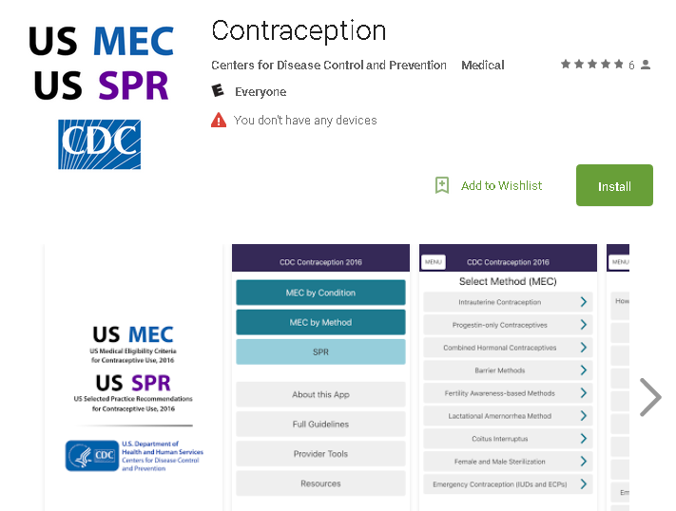
US Medical Eligibility for Contraception/ Special Practice Recommendations APP
Notes:
You can find the Medical eligbility app by Searching for “CDC MEC” in app store. It’s free. Many of the residents who rotate with us choose to download this and I think they find it helpful.

Slide 36
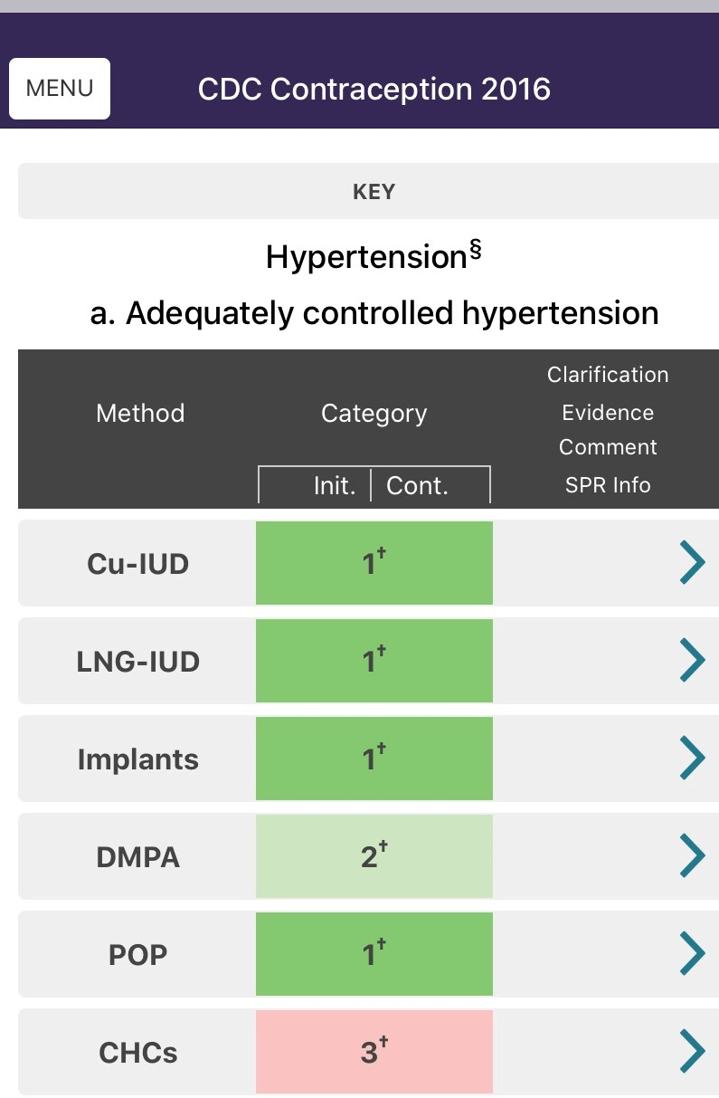
Notes:
Let me start by saying there is NOT a lot of data specific to pediatric patients, so a lot of times we have to consider individual risk factors and then try to help the patient come up with the best plan.
This is a screen shot of what you would see if you looked up the MEC for a patient with adequately controlled hypertension.
So you see that most methods—copper IUD, Progestin IUD, Implants, and progestin only pills, are considered risk level 1 (no restriction)
But Depo Provera is considered level 2, and combined hormonal contraceptives—meaning estrogen containing pills, patches, and rings—are considered level 3, because all of these may raise systolic blood pressure. If you want more information about a specific topic, you can click on that link for clarification of evidence.

Slide 37
Case #1: 17 yo with lupus
2 pulmonary emboli
Antiphospholipid antibody syndrome
Now having heavy bleeding and anemia with anticoagulation
Has a hard time remembering to take pills
Needs contraception
Notes:
So, getting back to this case, we have the young woman with antiphospholipid antibody syndrome who is now anticoagulated and having heavy periods and needing birth control

Slide 38
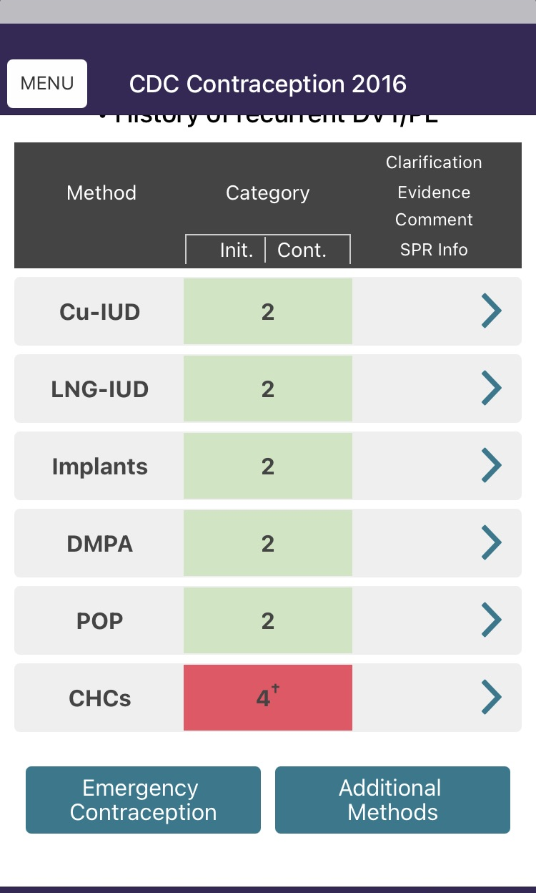
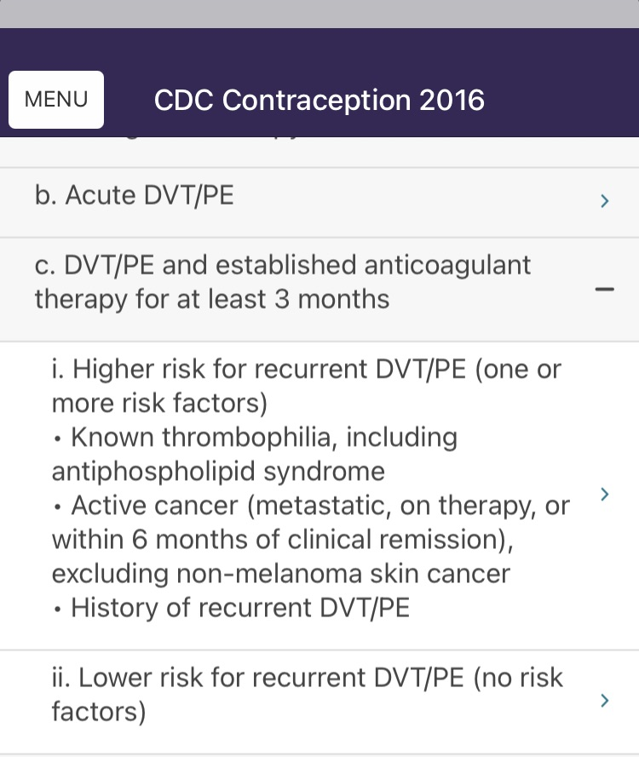
Notes:
So in her case, the CDC recommendations are clearcut and this is what you would see if you looked up pulmonary embolism in the MEC app. She has had recurrent PE and is established on anticoagulant therapy. She has a known thrombophilia, and so for her combined hormonal contraception is contraindicated.

Slide 39
What is the goal? Amenorrhea AND contraceptive efficacy
Hormonal contraceptive | Rate of amenorrhea at 1 year | Comments
Continuous Norethindrone Acetate (2.5-5 mg daily)¹ | 94% | Side effects: bloating, appetite Expensive
Continuous combined hormonal contraceptive (including ring) ² | 80-90% | Prior authorization sometimes required
DMPA injections³ | 70-75% (incr with time) | Side effects: weight gain, ? Bone density
Mirena IUD⁴ | 50% | Other 50% greatly reduced, FDA indication for HMB
Etonogestrel subdermal implant⁵ | 40% | 10% get heavier bleeding
Notes:
So what are our goals, and what are her goals? In this case, reducing or eliminating periods is important in order to treat her anemia.
Remembering back to this slide, continuous progestin pills did not seem to be a great option because she had a hard time adhering to a pill schedule.
Combined (estrogen containing) pills and rings are contraindicated. She did not like the idea of weight gain with Depo Provera.
So she elected to have a Mirena IUD placed under sedation.
This choice was safe for her, extremely effective as contraception, and very likely to help with her anemia by reducing or eliminating bleeding

Slide 40
Case #2: 12 year old with Von Willebrand’s disease
First menses: comes into ER with bleeding lasting 2 weeks, Hgb of 8
Syncope at school

Slide 41
Abnormal uterine bleeding
2013 ACOG Acute AUB guidelines:
IV estrogen
Monophasic OCP q8 x 7 days
Oral MPA 20 mg q8 x 7 days
TXA
SG: For pragmatic reasons, taper to OCP or NETA reasonable

Slide 42
Case #3
16 year old whose mother has a history of DVT with birth control pill use
Wants to have “a regular period, like my friends”

Slide 43
Avoiding thrombosis risk
Don’t have to perform tests
Choose a progestin-only method
For a regular period, consider DRSP only 24/4 or a hormone free or low dose LNG IUD

Slide 44
Summary
Many options exist for hormonal management of menses.
When in doubt, leave estrogen out!
Think outside the box: the best option is often an IUD. Consider sedation.
If you need consultation, seek out adolescent medicine or gynecology.
Notes:
In summary, many options exist…

Slide 45
***Excellent reference from FWGBD***
Baldwin MK, Samuelson Bannow B, Rosovsky RP, Sokkary N, Srivaths LV. Hormonal therapies in females with blood disorders: thrombophilia, thrombosis, hemoglobinopathies, and anemias. Res Pract Thromb Haemost. 2023 Apr 24;7(4):100161. doi: 10.1016/j.rpth.2023.100161.

Slide 46
Questions? smh5g@virginia.edu
Notes:
This is the most famous building at the University of Virginia. The University of VA is located in Charlottesville, VA. I hope you all will come and visit and see it in person because it is a very beautiful place

Slide 47
References
ACOG Practice Bulletin. Use of hormonal contraception in women with co-existing medical conditions. Obstet Gyn 2006;107:1453-1472
Adams A, Smith A. Risk perception and communication: recent developments and implications for anaesthesia. Anaesthesia 2001;56:745-55
Adolescents and Long-acting reversible contraception: implants and intrauterine devices. Committee Opinion No.539. American College of Obstetricians and Gynecologists. Obstet Gynecol 2012:120;983-8.
Calman K, Royston G. Risk language and dialects. BMJ 1997;315:939-42.
Contraception and Adolescents. Committee on Adolescence. Pediatrics Sep 2014, peds.2014-2299 www.pediatrics.org/cgi/doi/10.1542/peds.2014-2299

Slide 48
References
Cromer BA et al. A prospective comparison of bone density in adolescent girls. J Pediatr 1996 Nov;129(5):671-6. doi: 10.1016/s0022-3476(96)70148-8.
Curtis KM, Tepper NK, Jatlaoui TC, et al. U.S. Medical Eligibility Criteria for Contraceptive Use, 2016. MMWR Recomm Rep 2016;65(No. RR-3):1–104. DOI: http://dx.doi.org/10.15585/mmwr.rr6503a
Emans SJ. Contraception. In Emans SJ, Laufer MR (eds). Emans, Laufer, Goldstein’s Pediatric and Adolescent Gynecology, 6th Edition, Lippincott Williams Wilkins, 2012

Slide 49
References
Iversen L, Fielding S, Lidegaard Ø, Mørch LS, Skovlund CW, Hannaford PC. Association between contemporary hormonal contraception and ovarian cancer in women of reproductive age in Denmark: Prospective, nationwide cohort study. BMJ. Published online 2018. doi:10.1136/bmj.k3609
Management of acute abnormal uterine bleeding in nonpregnant reproductive-aged women. Committee Opinion No. 557. American College of Obstetricians and Gynecologists. Obstet Gynecol 2013; 121:891–6.
Mørch LS, Skovlund CW, Hannaford PC, Iversen L, Fielding S, Lidegaard Ø. Contemporary Hormonal Contraception and the Risk of Breast Cancer. N Engl J Med. Published online 2017. doi:10.1056/nejmoa1700732

Slide 50
References
Skovlund CW, Mørch LS, Kessing LV, Lidegaard O. Association of hormonal contraception with depression. JAMA Psychiatry. Published online 2016. doi:10.1001/jamapsychiatry.2016.2387
Sidney S et al. Recent combined hormonal contraceptives and the risk of thromboembolism and other cardiovascular events in new users. Contraception 2013:87:93-100
Teichmann A, Apter D, Emerich J, Greven K, Klasa-Mazurkiewicz D, Melis GB, et al. Continuous, daily levonorgestrel/ethinyl estradiol vs. 21-day, cyclic levonorgestrel/ethinyl estradiol: efficacy, safety and bleeding in a randomized, open-label trial. Contraception. 2009

Slide 51
References
Trenor CC, Chung RJ, Michelson AD, et al. Hormonal Contraception and Thrombotic Risk: A Multidisciplinary Approach. Pediatrics. 2011;127(2):347-357. doi:10.1542/peds.2010-2221
van den Heuvel MW, van Bragt A, Albawy A, Kaptein M. Comparison of ethinylestradiol pharmacokinetics in three hormonal contraceptive formulations: the vaginal ring, the transdermal patch and an oral contraceptive. Contraception 2005;72:168-174
Vercellini P, Bracco B, Mosconi P, Roberto A, Alberico D, Dhouha D, et al. Norethindrone acetate or dienogest for the treatment of symptomatic endometriosis: A before and after study. Fertil Steril. 2016
Warholm L, Petersen KR, Ravn P. Combined oral contraceptives’ influence on weight, body composition, height, and bone mineral density in girls younger than 18 years: A systematic review. Eur J Contracept Reprod Heal Care. Published online 2012. doi:10.3109/13625187.2012.692411

Slide 52
How to communicate very low absolute risk?
Dying on the road over 50 years of driving 1 in 85
Annual risk of death from smoking 10 cigs/d 1 in 200
Injury by a mattress or pillow needing ER 1 in 2000
Death by an accident at home 1 in 7100
Death playing soccer 1 in 50,000
Being hit by airplane crashing in your home 1 in 250,000
Dying of blood clot due to OCP 1 in 2,000,000
Being struck by lightning 1 in 10,000,000
Sources: Calman K et al . Risk language and dialects. BMJ 1997.
Adams A et al Risk perception and communication... Anaesthesia 2001.
Notes:
So, how do we explain the magnitude of the risks of using hormones to patients? Patients come to see us and often ask about side effects. One strategy to try is to use what’s called a “risk ladder” in which you compare the absolute risk of being harmed by birth control to other known risks. For those of us who have patients who think about worst case scenarios, I think this is very helpful.
It’s true that starting estrogen containing birth control may triple the risk of blood clot, but in terms of the absolute magnitude of risks The risk of a healthy young woman who starts birth control experiencing a blood clot that causes her death is 2 in a million, so it’s eight times more likely she will be hit by an airplane crashing into her home.
Another way of communicating this risk is to say that it’s “minimal”.
The risk of a healthy young woman who starts birth control experiencing a blood clot, but one that does not cause her death is about 1 in 10,000, so on the order of death by accident at home.
It’s worth pointing out that death by an accident at home is a much greater (280 times greater) risk than dying of a blood clot due to OCPs.

Slide 53
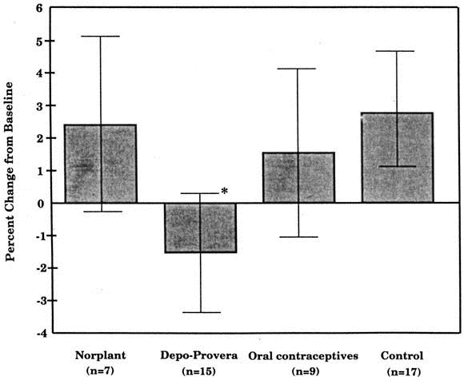
DMPA and bone density
Source: Cromer BA et al. A prospective comparison of bone density in adolescent girls. J Pediatr 1996.
Notes:
This is the graph I think of every time I think of Depo Provera, which is the reason it has a Black box warning. Here you can see a small study of teenaged girls bone density over a year. You can see in the control group, the bone density goes up, as it does for Norplant (the old version of Nexplanon) and oral contraceptives. However -the low estrogen levels induced by Depo seem to lead toloss of bone density. OF NOTE, this is less bone loss than occurs with pregnancy, and we now think it is mostly reversible if used for 2 years or less, but this is what makes Depo use controversial for younger girls at a time when they should have peak bone mass accrual.
If you think you have a patient who really would benefit from using it for a prolonged period, Consider getting a baseline DXA and advise them to participate in weight bearing exercise, consider checking their vitamin D level.

