Slide 1
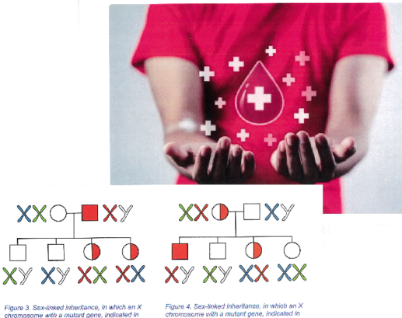
Hemophilia Carriers and X-inactivation
Bruce R Haas, MS LCGC
12 April 2024

Slide 2

Why are some males more severely affected with Hemophilia than other males?
The amount of clotting activity depends on the Clotting Factor alteration that results in Hemophilia. This is true for both F8 and F9.

Slide 3
Why are some carriers more severely affected than other carriers?
…if a women gets Hemophilia from both her Mom and Dad she can be as affected with Hemophilia as the boys and men in her family

Slide 4
A woman having F9 Deficiency from both her father and her mother
Her father’s F9 value: Tests: (1) Factor 9 (FIX)
F IX [LL] "Result Below..." 0.60-1.50
RESULT: 0.04 Repeated and verified U/mL

Slide 5
A woman having F9 Deficiency from both her father and her mother
Her son’s F9 value: Tests: (1) Factor 9 (FIX)
F IX [LL] "Result Below..." 0.60-1.50
RESULT: 0.03 Repeated and verified U/mL

Slide 6
A woman having F9 Deficiency from both her father and her mother
Her F9 value: Tests: (1) Factor 9 (FIX)
F IX [LL] "Result Below..." 0.60-1.50
RESULT: 0.04 Repeated and verified U/mL

Slide 7

Why are some carriers more severely affected than other carriers?
Most carrier girls / women only inherit Hemophilia from one parent, not both. So why do these females vary in how severe they are affected?

Slide 8

That requires a more complicated answer!
.

Slide 9

An important clue didn’t happen until 1959

Slide 10




Children with Down Syndrome are a part of the story as to variability between F8 and F9 carriers
.

Slide 11

DS history
The syndrome is named after British physician John Langdon Down, who fully described the syndrome in 1866. Some aspects of the condition were described earlier by French psychiatrist Jean-Étienne Dominique Esquirol in 1838 and French physician Édouard Séguin in 1844.

Slide 12

Children with Down Syndrome
.
Common features include:
Heart defects
Rudimentary teeth
Hearing loss
Protruding tongue
Floppy babies
Shorter than brothers or sisters
Limitations in understanding and in schooling—that of a 4- year-old for the rest of one’s life

Slide 13
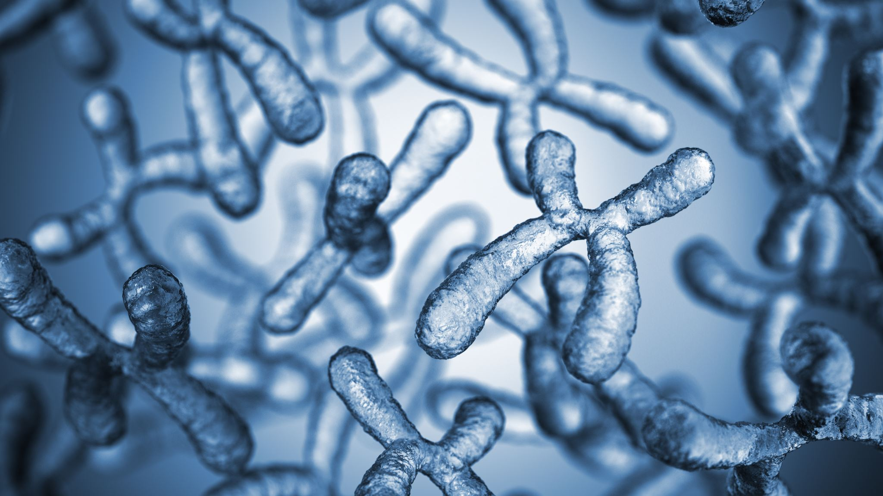
In 1959, the French physician Jérôme Lejeune identified Down syndrome as a chromosomal condition. Instead of the usual 46 chromosomes present in each cell, Lejeune observed 47 in the cells of individuals with Down syndrome.
Only later was it determined that an extra copy of chromosome 21 results in the characteristics associated with Down syndrome.
In the year 2000, an international team of scientists successfully identified and catalogued each of the approximately 329 genes on chromosome 21.

Slide 14
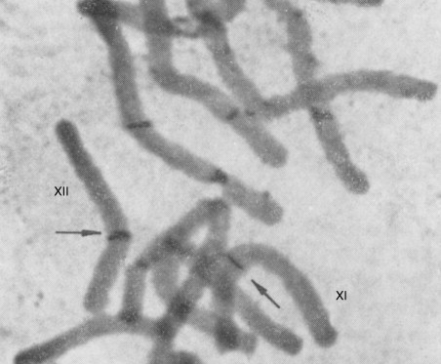

Slide 15
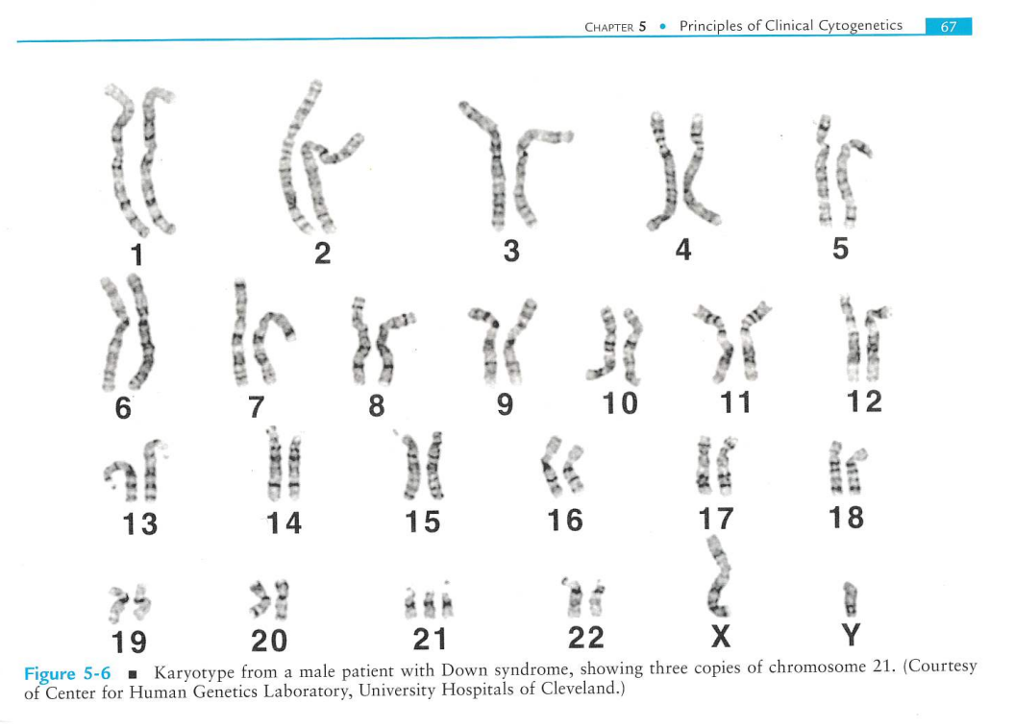
Notes:
The introduction of chromosome banding in 1969–70 has been one of the most important innovations in cytogenetics. The discovery was first made in Vicia faba by the group of Caspersson and Zech with quinacrine that intercalated into DNA producing dark and light Q-bands visible by UV microscopy along each chromosome [69]. Lore Zech discovered in the following year that all human chromosomes could be identified from one another by Q-banding [70]. Her pioneering work on Q-banding and its application to the recognition of chromosome aberrations in leukaemia and lymphomas are not sufficiently acknowledged [71].

Slide 16


Slide 17
A second X-chromosome is much bigger than a small Chromosome 21!

Slide 18
Mary Lyon asked…
But an X-chromosome is much larger than both chromosome 21 and the Y chromosome… then why do females with two large X-chromosomes not have signs of gene overload compared to males who typically have a single X and a single Y?
So if a third Chromosome 21—the smallest of human chromosomes—causes the many health issues in those with Down Syndrome…

Slide 19

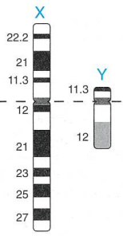



If an extra 21 is overload, why isn’t having a second X ?????????????
$$≫$$
$$≫$$

Slide 20
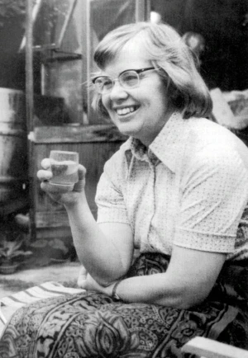
Those were questions perplexing scientist Mary Frances Lyon starting in 1959…
By 1961 she proposed in Nature that one of the two X chromosomes in every cell of female mammals is inactivated. This, she argued, occurs to prevent XX female cells from expressing twice as many X-linked gene products as XY male cells.

Slide 21
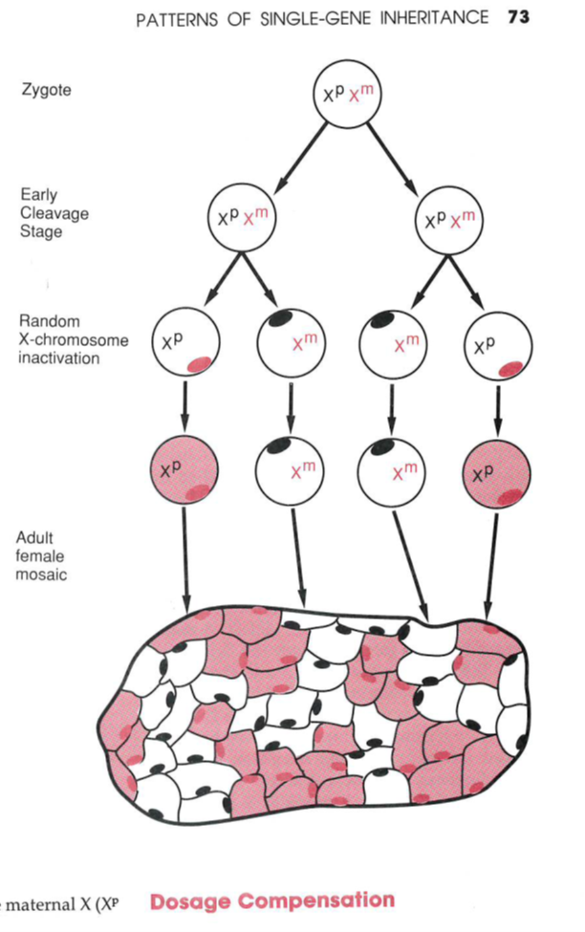
Lyon’s X-chromosome inactivation hypothesis had profound implications for clinical genetics and developmental biology.
It helped researchers elucidate the genetic basis for many X-linked diseases such as Duchenne muscular dystrophy (DMD).
It also led thirty years later to the discovery of the XIST gene which helped spawn a whole field of research on the role of long non-coding RNA molecules in regulating gene expression.

Slide 22
In each cell any X chromosome
beyond the first is turned off

Slide 23

,
In 1961, Mary Frances Lyon proposed in Nature that one of the two X chromosomes in every cell of females is inactivated. This, she argued, occurs to prevent XX female cells from expressing twice as many X-linked instructions as XY male cells.
.
Notes:
Born 15 May 1925 · Norwich, England
Died 25 December 2014 (aged 89)

Slide 24
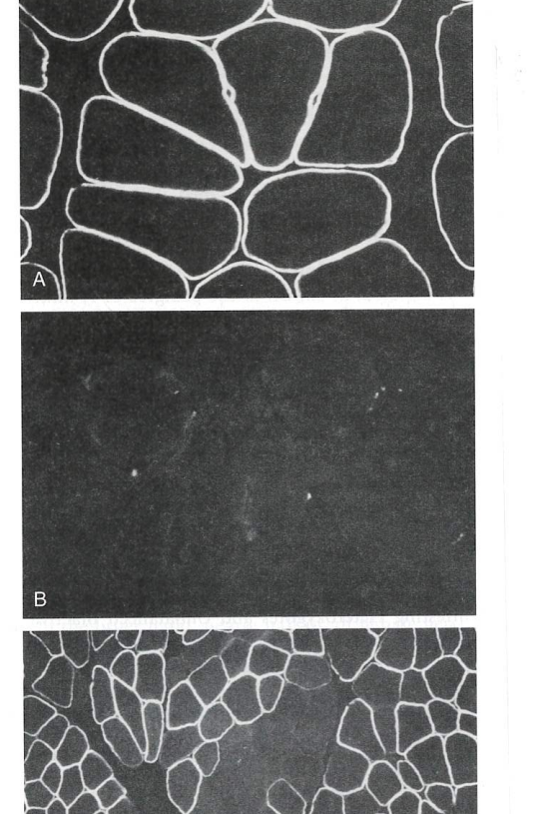
X-inactivation demonstration
Top: female not carrying a Dystrophin alteration
Middle: Male with Duchenne Muscular Dystrophy (DMD)
Bottom: Female heterozygous for DMD

Slide 25
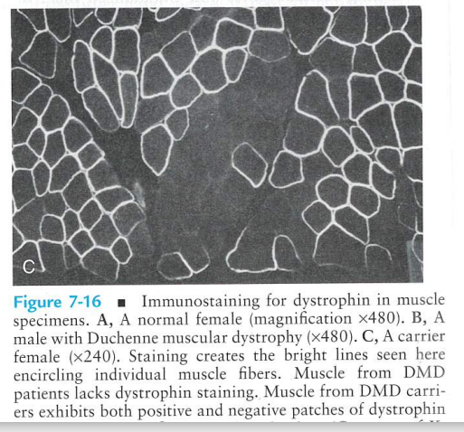
Phenomenon of X-inactivation
Positive stain on muscle cells in which the Dystrophin gene is fully functional
Negative stain on muscle cells in which the Dystrophin gene alteration is active

Slide 26

Want another example?
Calico cats have two colors of fur on an otherwise white background and are almost always female. Lyon originally proposed that this coat color pattern arises from the inactivation of one or the other of the two X chromosomes in females, during early embryogenesis. In the orange patches, the X chromosome with the allele that results in brown color is inactivated, while in the brown patches, the X chromosome with the allele that results in orange color is inactivated. Inactivation of the X chromosome, also known as lyonization, occurs randomly, resulting in a unique mosaic of Calico fur coat colors.

Slide 28
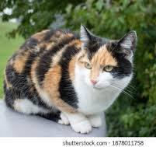

Slide 29
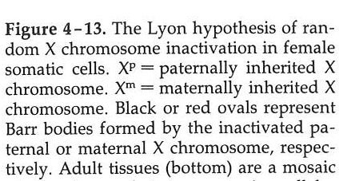
In honor of Dr. Mary Lyon, X-chromosome inactivation
was named Lyonization

Slide 30

What if?
Instead of half and half—half of a woman’s cells having her mother’s X-chromosome active and half of her cells having her father’s X-chromosome active, what if inactivation is very uneven?

Slide 31
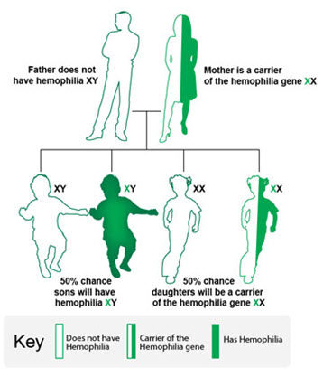
Like many other things about people…
Girls with most cells having Dad’s X active
Girls with most cells
having Mom’s X active

Slide 32
Person | Status | FVIII | Gene Alteration
Proband 1 | Affected | <0.01 | F8 Intron 22 inversion
Daughter 1 of Proband | Carrier | 0.62 | F8 Intron 22 inversion
Daughter 2 of Proband | Carrier | 1.02 | F8 Intron 22 inversion
Daughter 3 of Proband | Carrier | 0.43 | F8 Intron 22 inversion
Proband 2 | Affected | <0.01 | F8 Intron 22 inversion
Mother of Proband 2 | Carrier | 0.80
Sister 1 of Proband 2 | Carrier | 0.62 | F8 Intron 22 inversion
Son of Sister 1 | Affected | <0.01 | F8 Intron 22 inversion
Daughter of Son Granddaughter of Sister 1 | Carrier | 0.38 | F8 Intron 22 inversion
Sister 2 of Proband 2 | Carrier | 1.35 | F8 Intron 22 inversion
Son 1 of Sister 2 | Affected | <0.01 | F8 Intron 22 inversion
Son 2 of Sister 2 | Affected | <0.01 | F8 Intron 22 inversion
Daughter of Son 2 Granddaughter of Sister 2 | Carrier | 0.55
Proband 3 | Affected | 0.01 | F8 c.5822A>G p.Asn1941Ser
Mother of Proband 3 | Carrier | 0.60 | F8 c.5822A>G p.Asn1941Ser
Sister of Proband 3 | Carrier | 0.38 | F8 c.5822A>G p.Asn1941Ser
Proband 4 | Affected | <0.01 | F8 c.5177G>A p.Trp1726Stop
Mother of Proband 4 | Carrier | 0.72 | F8 c.5177G>A p.Trp1726Stop
Sister of Proband 4 | Carrier | 0.40 | F8 c.5177G>A p.Trp1726Stop
Maternal aunt of Proband 4 | Carrier | 0.26 | F8 c.5177G>A p.Trp1726Stop
Maternal 1st cousin of Proband 4 | Affected | <0.01 | F8 c.5177G>A p.Trp1726Stop
Maternal 1st cousin of Proband 4 | Carrier | 0.36 | F8 c.5177G>A p.Trp1726Stop
 | Carriers (n = 14) |  | Range = 0.26 – 1.35
 | Affected males (n = 8)

Slide 33
Person | Status | FVIII | Gene Alteration
Proband 1 | Affected | <0.01 | F8 Intron 22 inversion
Daughter 1 of Proband | Carrier | 0.62 | F8 Intron 22 inversion
Daughter 2 of Proband | Carrier | 1.02 | F8 Intron 22 inversion
Daughter 3 of Proband | Carrier | 0.43 | F8 Intron 22 inversion
Proband 2 | Affected | <0.01 | F8 Intron 22 inversion
Mother of Proband 2 | Carrier | 0.80
Sister 1 of Proband 2 | Carrier | 0.62 | F8 Intron 22 inversion
Son of Sister 1 | Affected | <0.01 | F8 Intron 22 inversion
Daughter of Son Granddaughter of Sister 1 | Carrier | 0.38 | F8 Intron 22 inversion
Sister 2 of Proband 2 | Carrier | 1.35 | F8 Intron 22 inversion
Son 1 of Sister 2 | Affected | <0.01 | F8 Intron 22 inversion
Son 2 of Sister 2 | Affected | <0.01 | F8 Intron 22 inversion
Daughter of Son 2 Granddaughter of Sister 2 | Carrier | 0.55
Proband 3 | Affected | 0.01 | F8 c.5822A>G p.Asn1941Ser
Mother of Proband 3 | Carrier | 0.60 | F8 c.5822A>G p.Asn1941Ser
Sister of Proband 3 | Carrier | 0.38 | F8 c.5822A>G p.Asn1941Ser
Proband 4 | Affected | <0.01 | F8 c.5177G>A p.Trp1726Stop
Mother of Proband 4 | Carrier | 0.72 | F8 c.5177G>A p.Trp1726Stop
Sister of Proband 4 | Carrier | 0.40 | F8 c.5177G>A p.Trp1726Stop
Maternal aunt of Proband 4 | Carrier | 0.26 | F8 c.5177G>A p.Trp1726Stop
Maternal 1st cousin of Proband 4 | Affected | <0.01 | F8 c.5177G>A p.Trp1726Stop
Maternal 1st cousin of Proband 4 | Carrier | 0.36 | F8 c.5177G>A p.Trp1726Stop
 | Carriers (n = 14) |  | Range = 0.26 – 1.35
 | Affected males (n = 8)

Slide 34
Person | Status | FIX
Proband | Affected | 0.06
Mother of Proband | Carrier | 0.37
Sister 1 of Proband | Carrier | 0.44
Son of Sister 1 | Affected | 0.07
Sister 2 of Proband | Carrier | 0.58
Son of Sister 2 | Affected | 0.03
Son of Sister 2 | Affected | 0.04
Daughter of Sister 2 | Carrier | 0.29
Daughter of Sister 2 | Carrier | 0.54
Sister 3 of Proband | Carrier | 0.72
Son of Sister 3 | Affected | 0.03
Sister 4 of Proband | Carrier | 0.78
Son of Sister 4 | Affected | 0.05
Daughter of Sister 4 | Carrier | 0.43
Daughter 1 of Proband | Carrier | 0.42
Daughter 2 of Proband | Carrier | 0.66 / 0.74
Daughter of Daughter 2 | Carrier | 0.43
Daughter 3 of Proband | Carrier | 0.56
Son of Daughter 3 | Affected | 0.02
Daughter 4 of Proband | Carrier | 0.54
 | F9 c.1025C>T p.Thr342Met
 | Carriers (n = 13) | Range = 0.29 – 0.78
 | Affected males (n = 7) | 0.02 – 0.07

Slide 35
Person | Status | FIX
Proband | Affected | 0.06
Mother of Proband | Carrier | 0.37
Sister 1 of Proband | Carrier | 0.44
Son of Sister 1 | Affected | 0.07
Sister 2 of Proband | Carrier | 0.58
Son of Sister 2 | Affected | 0.03
Son of Sister 2 | Affected | 0.04
Daughter of Sister 2 | Carrier | 0.29
Daughter of Sister 2 | Carrier | 0.54
Sister 3 of Proband | Carrier | 0.72
Son of Sister 3 | Affected | 0.03
Sister 4 of Proband | Carrier | 0.78
Son of Sister 4 | Affected | 0.05
Daughter of Sister 4 | Carrier | 0.43
Daughter 1 of Proband | Carrier | 0.42
Daughter 2 of Proband | Carrier | 0.66 / 0.74
Daughter of Daughter 2 | Carrier | 0.43
Daughter 3 of Proband | Carrier | 0.56
Son of Daughter 3 | Affected | 0.02
Daughter 4 of Proband | Carrier | 0.54
 | F9 c.1025C>T p.Thr342Met
 | Carriers (n = 13) | Range = 0.29 – 0.78
 | Affected males (n = 7) | 0.02 – 0.07

Slide 36
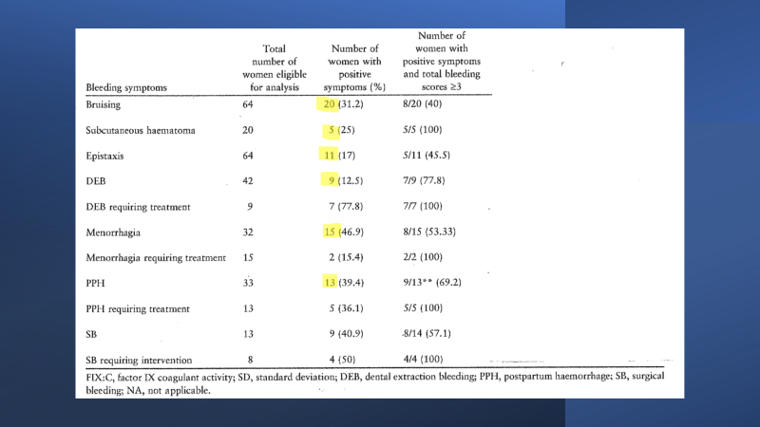

Slide 37


