Slide 1
Genetics and Bleeding Disorders
Krista Krol-Buch, MS, LGC
Nemours Children’s Health Cancer Genetics Program
Nemours Children’s Health Genetic Testing Stewardship Program

Slide 2
No Disclosures

Slide 3
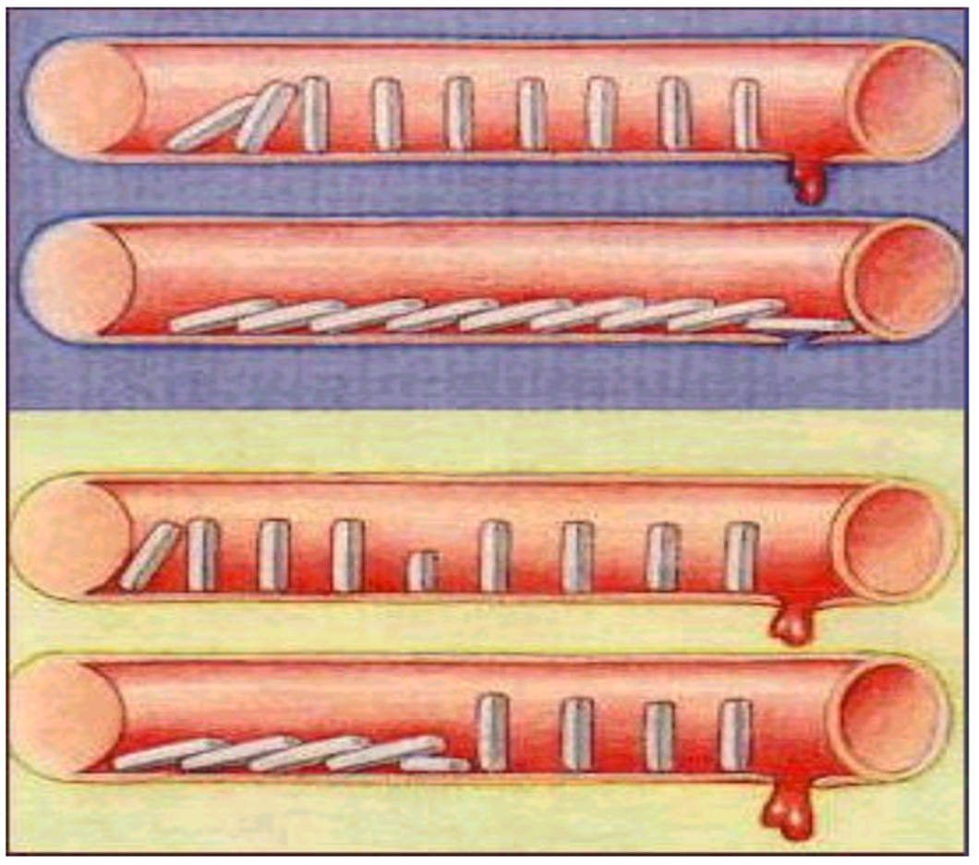

Slide 4
Is Genetic Testing Useful?
Confirmation of diagnosis
Prognosis/ Severity and clinical correlation
Pregnancy planning
Birth planning
Early diagnosis in newborns to avoid harm
Surgical planning
Specific management
Medications
Treatment
Gene therapy
Specific treatment centers!
Familial testing (especially asymptomatic carriers)
YES!

Slide 5
Excessive Bleeding
Hemophilia
von Willebrand Disease
Congenital Fibrinogen Disorder
Vitamin K Deficiency
Thrombocytopenia
Familial Platelet Disorders
Excessive Clotting
Factor V/Factor V Leiden
Prothrombin Mutations
Congenital Fibrinogen Disorder
Protein C Deficiency
Protein S Deficiency

Slide 6
What do I send? Where do I send it?
Versiti
Expensive, longer TAT, familial testing barriers
Prevention Genetics
Coagulation Factor Deficiency Panel
Bleeding Disorders Panel
Thrombocytopenia Expanded Panel
Primary Immunodeficiency Panel
Invitae
Bleeding Disorders Panel
Thrombocytopenia Panel
Primary Immunodeficiency Panel

Slide 7
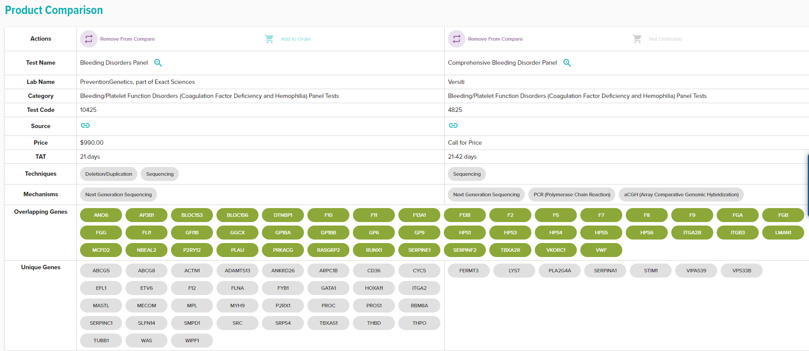
$2700-$3850

Slide 8
When in Doubt?

Slide 9
Now Lets Talk
Hypermobility……

Slide 10
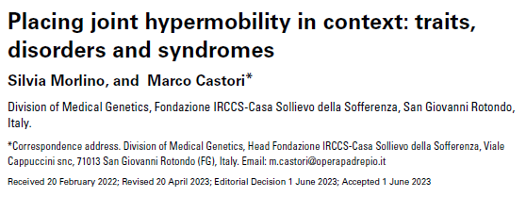
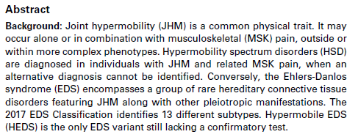

Slide 11
1. Joint hypermobility (JHM) is common in the general population and is often a benign trait without significant health-related manifestations.
2. If someone is hypermobile this doesn’t mean they will have bleeding
If someone has bleeding…. And is hypermobile… then pay closer attention!
3. Move away from saying hEDS!

Slide 12
Hypermobility Spectrum Disorders
GJH – Generalized joint hypermobility
GHSD – Generalized hypermobility spectrum disorder
HJH – historical joint hypermobility
HHSD – historical hypermobility spectrum disorder
LJH – Localized joint hypermobility
LHSD – Localized hypermobility spectrum disorder
PJH – Peripheral joint hypermobility
PHSD – Peripheral hypermobility spectrum disorder

Slide 13
When to send to Genetics
If seeing a patient with excessive bleeding +
Severe end of hypermobile
Translucent skin
Heart defect
Family history of aortic dissection
Bifid uvula
Noticeably dysmorphic

Slide 14
Ehlers Danlos Syndrome
Classic Ehlers Danlos Syndrome
Genes: COL5A1, COL5A2, COL1A1, TNXB
Cardiovascular involvement
Fragile skin, easy bruising, excess scars, skin hyperextensibility
Joint disclocations, club feet
Dysmorphic facial features
Vascular Ehlers Danlos Syndrome
Genes: COL3A1 and COL1A1
Mitral valve prolapse, multiple aneurysms
Spontaneous pneumothorax
Uterine rupture
Prominent veins, Fragile skin, excess scars, skin hyperextensibility, skin changes in low temperature
Organ prolapse

Slide 15
Other Genetic Conditions to Think of!
Noonan Syndrome
Familial HLH
Hermansky Pudlak/Chediak Higaski
Hereditary Hemorrhagic Telangiectasia
Klinefelter Syndrome
Juvenile Polyposis Syndrome
Autoimmune/Autoinflammatory (can be genetic!)
Bone Marrow Failure Syndromes

