Slide 1
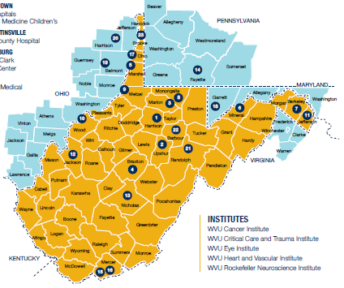
Quality improvement reduced bleeding and hospital costs
Samuel Merrill MD PhD
Classical Hematology
Medical Director, Hemophilia Treatment Center
Region III Meeting, Alexandria VA
4/12/2024
Notes:
30min

Slide 2
Disclosures
Scientific advisory board: Roche
Consultancy: Sanofi-Genzyme
No 340b program/revenue conflict of interest

Slide 3
Background
Persons with congenital bleeding disorders (PwCBD) have complex care needs
Hospitalizations and ER visits are common for PwCBD
Some hospitalizations and ER visits for bleeding are preventable (PHER)
Systems of care could be changed to reduce PHER

Slide 4
Genesis
December 2018: dental care needs identified on WVU interview (RN Sylvia)
  How do other programs tackle dental care need?
Barriers to attain HTC resources
  Circular barriers: no $, not enough patients, no resources
9/25/19: urgent evaluation
  PwModHB: Urgent transfer from another HTC, difficulty with adherence, urgent dental extraction needed. No regular dental care, 8th grade education, runs drilling rig. Out of date factor by over 1 year.
10/19/19: initial hemophilia clinic
  PwModHA: Monthly ankle bleeds, BIW SHL PPX, septic arthritis, “suffering in silence”, impairment at work requiring job change due to arthropathy, “can’t I just cut off the ankle…like under a train?”
  PwSHA: Recent transfer from another HTC. Monthly ankle bleeds, BIW SHL prophylaxis, job limitations due to frequent bleeding and arthropathy.
  “So you’re my doctor this year?”
  Most patients did not show for HTC visits

Slide 5
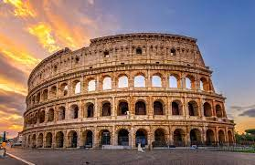
3 year strategic plan
Expand 340b
Increase revenue
Improve services
Increase patients
Reduce costs
Expand services

Slide 6
DMAIC
Define: problem, Critical-to-Quality characteristic (CTQ)
Measure: current processes, needs
Analyze: what is not working? Why?
Improve: fix it
Control: keep positive gains

Slide 7
Inputs to make a better HTC
Patients
Staff
Guidelines, MASAC recommendations
Research (before guideline incorporation)
Common sense: the most difficult to prove
Non-hematologist input (OB/GYN, lab medicine, pharmacy)
Other HTC programs (AKA the competition)
Prior services no longer currently offered (dental, ortho, phone line)
To obtain needed resources, emphasis on financial impact

Slide 8
Define
HTC patients (adults), PwCBD
CTQ metric: preventable hospitalizations and ER visits for bleeding (PHER)
Secondary: use of PPX, EHR portal, PCP, PHER cost
Target: ambulatory care processes

Slide 9
Measure: patient needs
Ask patients: they were very willing to share
“Why do you keep sending me that survey when you never do what I suggest? I stopped filling them out.”

Slide 10
2014, 2017 HTC surveys
2019 WV NBDF meeting
“Have a direct phone line to nurse coordinator.”
Communication difficulty
Timely appointments (availability)
Limited services available
Quality of care
Care coordination
Low scores for PCP coordination, provider coordination, ease of care, and ability to reach HTC urgently

Slide 11
Measure
ATHN database and data entry (limitation)
Epic data pull (manually)
3yr review: preventable hospitalizations were common
  “out of factor and bleeding”
  Bleeding and not using prophylaxis (PwSHA/PwSHB)
  Sequelae of poor dental care
  Septic joints
  Poor follow up, poor use of prophylaxis

Slide 12
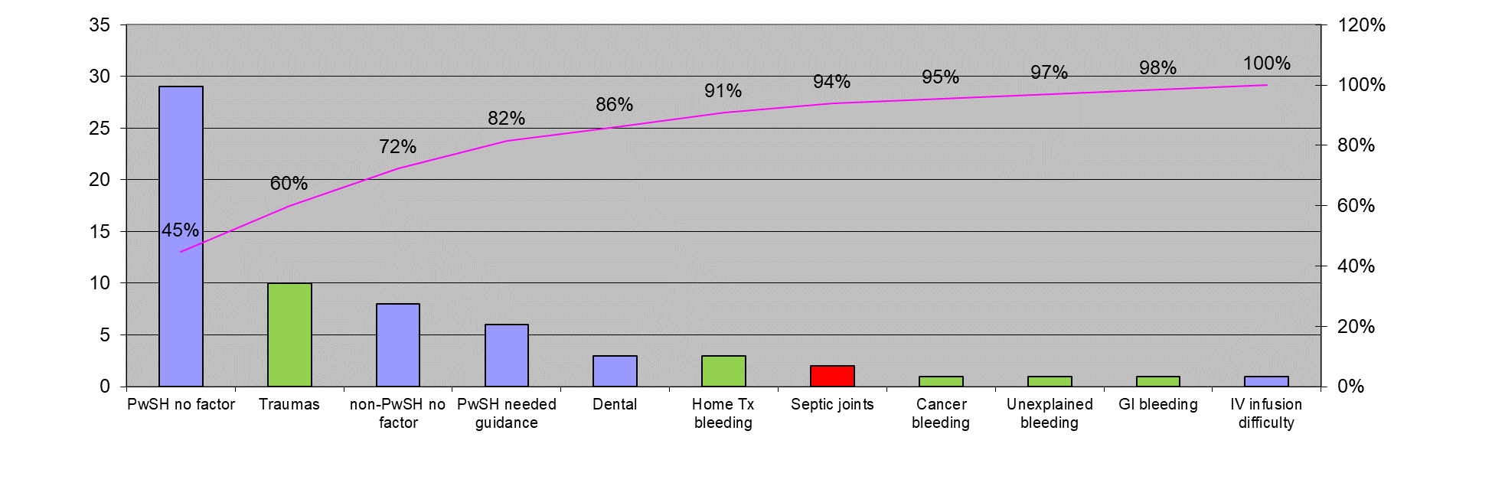
Measure-Analyze

Slide 13
Analyze

Slide 14


QI Umbrella: resiliency redundancy
Poka-yoke
Prevent bleeds: prophylaxis, PRN doses at home, novel therapy (emicizumab), antifibrinolytics, patient education
Access to care: urgent visits, reserved clinical time, encourage follow ups, return patient calls promptly, use of telemedicine
Communication: MyChart, phone line, procedural plans, communication to primary care
Expectations: timelines for surgery, factor requests
Logistics: blood bank, lab testing
Additional services: dental care, mental health
Prevention: get a PCP, test for HIV, test for HCV, evaluate cirrhosis
Procedure management: plans, pharmacy, perioperative safety

Slide 15





Analyze: Goal 100—Goal 0
Goal 100
  Use of prophylaxis (PwSHA, PwSHB)
  Use of prophylaxis (lab mild/moderate with severe phenotype)
  Have a PCP
  Written procedure management plans
  Timely return of patient calls (within 1hr)
  Enrollment in patient portal
  Dental care
  Is hemostatic therapy working?
  Preventative visits
Goal 0
  “Out of factor and bleeding”
  Preventable hospitalizations and ER visits (PHER)
  Spontaneous bleeds
PwCBD 100
Hemophilia 0

Slide 16
Improve
Physician Checklist at visits
  Goal 100-Goal 0, & Guideline based care
  Proactive poka-yoke
Timely return of patient requests
  1hr, triaged by physician
  Reactive poka-yoke
Dedicated physician time for urgent management
  Was volunteered effort

Slide 17
Control
Q6 month analysis of PHER
Reactive poka-yoke
Final Analysis

Slide 18
Data analysis
Adult patients treated at the HTC
  Excluded acquired hemophilia
Baseline: 12/15/2016—12/15/2019
Intervention: 12/16/2019—12/16/23
  Stopped early due to resource limitations: 7/22/22
  Clinical effort not supported
  Blinded: preventable vs non-preventable
  Cycles:
    “Hidden factory”: dental care, peri-operative safety
    “impossible” telemed situations

Slide 19
Demographics
 | Baseline cohort 12/15/2016-12/15/2019 |  | Intervention cohort 12/16/2019-7/22/2022
Demographic Characteristic | No. (%) | Median (range) | No. (%) | Median (range)
Age, yrs | 62/62 (100) | 39.5 (18-80) | 88/88 (100) | 42.5 (21-81)
Sex, male | 47/62 (75.8) | - | 60/88 (68.2) | -
Follow up, days | 63,287 | 1,095 (53-1,095) | 68,556 | 950 (16-950)
Race
White | 59/62 (95.2) | - | 85/88 (96.6) | -
Black | 1/62 (1.6) | - | 1/88 (1.1) | -
Hispanic | 2/62 (3.2) | - | 2/88 (2.3) | -
 | No. | % | No. | %
Active cancer | 2/62 | 3.2% | 5/88 | 5.7%
Dementia | 3/62 | 4.8% | 4/88 | 4.5%
Cirrhosis | 4/62 | 6.5% | 5/88 | 5.7%
BMI >30 | 33/62 | 53.2% | 46/88 | 52.3%

Slide 20
Demographics
Baseline cohort 12/15/2016-12/15/2019 |  | Intervention cohort 12/16/2019-7/22/2022
No. | % | No. | %
Hemophilia A | 33/62 | 53.2% | 42/88 | 47.7%
HA with inhibitor | 2/62 | 3.2% | 3/88 | 3.4%
Hemophilia B | 12/62 | 19.4% | 15/88 | 17.0%
VWD | 8/62 | 12.9% | 13/88 | 14.8%
Platelet disorders | 3/62 | 4.8% | 3/88 | 3.4%
Ehlers-Danlos syndrome | 1/62 | 1.6% | 5/88 | 5.7%
BDUC | 2/62 | 3.2% | 5/88 | 5.7%
Factor XI | 1/62 | 1.6% | 3/88 | 3.4%
Factor X | 1/62 | 1.6% | 1/88 | 1.1%
Niemann-Pick | 1/62 | 1.6% | 1/88 | 1.1%

Slide 21
Outcome Measures | Baseline | Intervention | 95% CI
Proportion of patients with non preventable visits: | 0.19 | 0.17 | -0.145 to 0.105
Proportion of patients with preventable:
Hospitalization or ER visit | 0.24 | 0.05 | 0.074 to 0.306
ER visit | 0.19 | 0.03 | 0.056 to 0.264
Hospitalization | 0.13 | 0.02 | 0.021 to 0.199
Annualized preventable visit/patient: |  |  | RRR
Hospitalization or ER | 0.219 | 0.032 | 85.4%
ER | 0.127 | 0.021 | 83.2%
Hospitalization | 0.092 | 0.011 | 88.5%
P=0.75
P=0.0006
P=0.001
P=0.0075

Slide 22
Non-preventable visits
Baseline cohort 12/15/2016-12/15/2019 |  | Intervention cohort 12/16/2019-7/22/2022
High risk trauma | 10 | 11
Bleeding despite home therapy | 3 | 3
Malignancy and bleeding | 1 | 2
Unexplained hematuria | 1 | 1
Post-procedure bleeding | 1 | 1
High risk GI bleed (hematemesis, cirrhosis) | 1 | 5
Early pregnancy bleeding | 0 | 3

Slide 24
Visits and Intervention
Intervention management episodes | No. | Patients | Median* | Range*
Visits scheduled | 330 | 85/88 | 3 | 1-10
Visits attended | 182 | 80/85 | 2 | 1-10
Telemedicine attended | 19 | 13/85 | 1 | 1-5
Management, outside of visit | 1739 | 82/88 | 17 | 1-88
Managment, no visit scheduled | 5 | 1/3 | 1 | 0-5
 | No. | Patients | % | Range**
Urgent interventions | 135 | 63/88 | 71.6% | 1-10
Procedure plan | 60 | 38/88 | 43.2%
Bleeding | 37 | 25/88 | 28.4%
Other | 25 | 16/88 | 17.0%
Pregnancy/delivery plan | 6 | 3/88 | 3.4%
Orthopedic fracture | 5 | 3/88 | 3.4%
High-risk trauma | 2 | 2/88 | 2.3%
Only 55.2% of visits were attended

Slide 25
Telemedicine
Not a substitute for HTC visit (MD only)
  COVID-19 enabled change
Types: Video:8, Phone: 11
Reasons
  Travel/distance: 8
  New born care: 2
  Medical comorbidity: 3 (paralysis, unable to travel)
  Limited time off work: 3

Slide 26
Unplanned procedures were common
No. | Patients | %
Procedure management plans | 60 | 38 | -
Dental extraction | 18 | 14/38 | 30.0%
Orthopedic surgery | 7 | 7/38 | 11.7%
Ophthalmologic surgery | 6 | 3/38 | 10.0%
Endoscopy | 5 | 5/38 | 8.3%
Interventional radiology procedure | 5 | 4/38 | 8.3%
Dermatologic surgery | 4 | 2/38 | 6.7%
Gynecologic surgery | 3 | 3/38 | 5.0%
Gastroentestinal surgery | 3 | 3/38 | 5.0%
Otolaryngology surgery | 3 | 2/38 | 5.0%
Urologic surgery | 2 | 2/38 | 3.3%
Cardiology procedure | 2 | 2/38 | 3.3%
Neurologic surgery | 1 | 1/38 | 1.7%
Thoracic surgery | 1 | 1/38 | 1.7%

Slide 27
Outcome Measures | Baseline | Intervention
Patients, n | 62 | 88
Follow up, patient-days | 63287 | 68556
Non-preventable Hospitalization and ER visit, n | 17 | 26
Preventable ER visits, n | 22 | 4
Bleeding, PwSH without factor | 13 | 2
Bleeding, PwSH had factor | 4 | 0
Bleeding, without factor | 4 | 2
Infusion difficulty | 1 | 0
Preventable Hospitalizations, n | 16 | 2
Bleeding, PwSH without factor | 10 | 2
Bleeding, PwSH had factor | 3 | 0
Bleeding, without factor | 3 | 0
Total preventable charges | $2,689,278.79 | $341,812.98
Annualized charge (per patient*yr) | $15,510.09 | $1,819.85
Total preventable factor cost | $2,046,047.38 | $120,250.26
Annualized cost (per patient*yr) | $11,800.33 | $640.23
94.5% Reduction

Slide 28
 | Baseline cohort |  |  | Intervention cohort
Outcome Measure | No. | % |  | No. | % | 95% CI | P-value
Primary care provider (active) | 43/62 | 69.4% |  | 76/88 | 86.4% | 0.0348 to 0.305 | 0.012
Enrollment in patient portal | 33/62 | 53.2% |  | 73/88 | 83.0% | 0.151 to 0.445 | 0.001
Change in hemostatic therapy | Not assessed |  |  | 55/88 | 62.5% | N/A | N/A
Prophylaxis for severe | 10/17 |  | 58.8% | 18/18 | 100.0% | 0.178 to 0.646 | 0.0027
Emicizumab in hemophilia A | 1/33 |  | 3.0% | 19/42 | 45.2% | 0.260 to 0.583 | <0.0001
Clinical follow up adherence (2 visit in 3 years) | 44/62 |  | 71.0% | 65/88 | 73.9% | -0.117 to 0.175 | 0.696

Slide 29
PwSHA/B not using PPX?
Baseline: 7/17 not using PPX (non-exclusive reasons)
  Non-adherence to HTC visits: 4
  Burden of infusion: 3
  Incarceration:2
  Substance abuse:2
  Re-characterization by chromogenic assay: 2
  Cost: 1
Baseline: 2 “using PPX” were partially
  Non-adherence to HTC visits, burden of infusions, cost, insurance problems

Slide 30
Project conclusions
Benefit:
  Preventable ER or hospitalization: 85.4% reduction
  CFC savings: $982,088.87/year
  Healthcare “savings”: $1,204,740.56/year
Cost:
  Unreimbursed time (0.1 FTE would have worked)
  71.6% had an urgent episode, mean 0.72/year
  93% had non-visit management, mean 9.3/yr
  2.55 episodes per workday

Slide 31
Progress and Barriers
Cycles: what can we improve?
  Non-adherence: follow up, prophylaxis
  HTC transfer
  Unplanned procedures/interventions
  Dental care
  Perioperative care
Adherence:
Only 55.2% of visits were attended
  Phone calls x3, MyChart messages, written letter (standard procedures)
Using 2 visits in 3 years as metric: 71% Baseline vs 73.9% Intervention

Slide 32
Existential threat: 340b
DSH designation
Single contract pharmacy, very low utilization (N=9)
  Patients did not prefer vendor
  BCBS not able to use, declining 340b population
340b program was net revenue negative 2019-2020
  Despite revenue, it was net negative “fixed costs”
  Recent change was emicizumab fees, with less CFC revenue
  Even before the QI project started!
Administrative changes
  Expand contract pharmacies (N=3)
  Obtained contract pharmacies that insurance would allow (especially BCBS)
  Redundancy to enable increased patient use of 340b program

Slide 33
Win-win
Improved outcomes (PHER)
Reduced costs (no Cost of Quality)
  No temporary increased COQ from QI
  Helped by very low use of 340b program to start with
Increased revenue
We got the phone line 2 weeks before termination

Slide 34
Collaborators
Checklist available upon publication (accepted)
OB/GYN: Laura Merrill
MFM: Megan Varvoutis
TM/Pathology: Aaron Shmookler
RN: Sylvia Webber
WV NBDF: Chelsea Hilti, Fernando Andrejevski
Financial analyst: Jim Francher
Dental: Dr Marshall, Dr Kines, Dr Hubbard, Dr Nickoles, Gina Sharps
Pharmacy: Emma Platt
Perioperative: Christine Troy
Patients, family members, and caregivers

