Slide 1
Emi Surgery Project Update Mid-Atlantic/Region III HTC Annual Meeting April 11, 2024
Jan Kuhn
Colleen Druzgal
This Photo by Unknown author is licensed under CC BY-NC-ND.

Slide 2
Committee Members
Member | Discipline | HTC
Regina Butler | Nursing | CHOP
Colleen Druzgal | MD | UVA
Sue Gallagher | Nursing | CHOP
Lisa Maiale-Howell | Regional Administrator | CHOP
Brandon Lawryk | Research Associate | Western PA
Jan Kuhn | Nursing | VCU
Elle Levy | Nursing | CNH
Dyanne Morris | Nursing | Penn
Margy Sennett | Nursing | UVA
Kevin Todd | MD | CHKD
Eric Werner | MD | CHKD

Slide 3
Special thanks to data managers
Katherine Bains
Marylouise Mattia
Brandon Lawryk
Janice Kuhn
Gillian Jenkins
Deborah Vehec
Gail Long
Christopher Stearn
Janelle Humphrey-Rowan
Lindsay Comstock
Janelle Humphrey-Rowan
Michaela Ramandanes

Slide 4
Progress to date: 8 HTCs participating
CNH
CHOP
Cardeza
Hershey
VCU
UVA
Western PA
West VA Medical

Slide 5
Current participation
58 unique patients
16 current or history of inhibitor
Mild, moderate and severe diagnoses

Slide 6
Demographics:
All male

Slide 7
Demographic Characteristics: AGE
Range: 2- 85 years
42% under age 21 years

Slide 8
Age

Slide 9
Demographics: RACE

Slide 10
Demographics: Ethnicity

Slide 11
Patients by severity (n=58)

Slide 12
Ever had a known inhibitor

Slide 13
And now for the surgical results….
74 Surgeries
21 Major
53 Minor

Slide 14
Major Surgeries
N=21
Orthopedic n=14
All used factor
Other n=7
One used antifibrinolytic
One day
All used factor
6-day average (2-14 day range)
43% used antifibrinolytics
6 day average
(4-7 day range)
8-day average (1-15 range)

Slide 15
Minor Surgeries
N= 53
Scopes n=13
77% factor or bypass (1.5 d average;1-4 day range )
Orthopedic n=1
Dental n=24
3 days factor
61% used antifibrinolytic ( 5 d average;1-7 d range)
67% factor (1 d average; 1-3 day range)
67% antifibrinolytics (2.6 average; 1-5 day range)
8.3% no treatment
Other n=15
93% factor (2.5d average; 1-7 d range)
40% no fibrinolytics
One- no treatment
no antifibrinolytics

Slide 16
Closer look at scopes and dental
Scopes n=13
77% factor or bypass (1.5 d average;1-4 day range )
61% used antifibrinolytic ( 5 d average;1-7 d range)
Dental n=24
67% factor (1 d average; 1-3 day range)
67% antifibrinolytics (2.6 average; 1-5 day range)
8.3% no treatment

Slide 17
Excessive Bleeding Reported

Slide 18
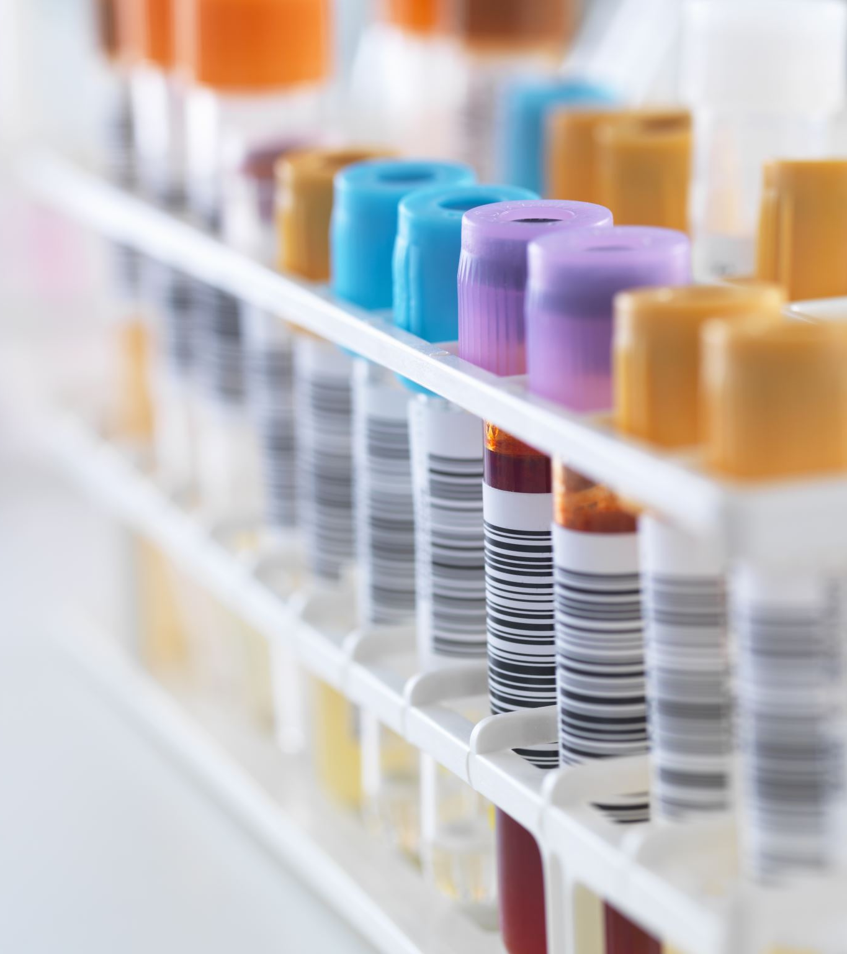
Considerations
No reported surgical complications
Only one surgery used a bypassing agent (Novoseven)
No unanticipated use of blood products

Slide 19
Conclusions….
The MAR Emi Surgery and Procedure Project provides real world data on the hemostasis management of patients taking Emi.
It’s time to get the word out!

Slide 21
Next steps
Recruit
Recruit additional sites; address barriers
Consider
Consider methodology for data analysis and data quality
Analyze
Other data questions—total usage by units/kg; using the data base as a reference tool; cost considerations; comparison to other studies

Slide 22
Acknowledgements
Region III leadership
MAR Emi Project Committee
MAR Community of Practice
HTC sites data coordinators and nursing support
Erika Martin
ATHN

